Slide 1


Introduction to Python – Matplotlib, Numpy, Widgets
Introduction to Experimental Neuroscience: Neurocomputation| July 2021
Eduarda Centeno
Monday, 26th of July

Slide 2
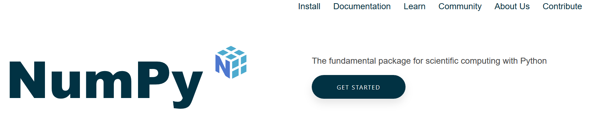
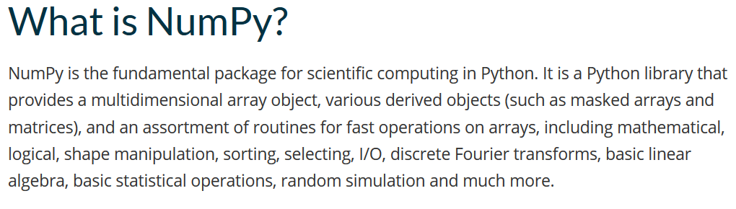
Numpy for numerical computing
The library:
https://numpy.org/

Slide 3
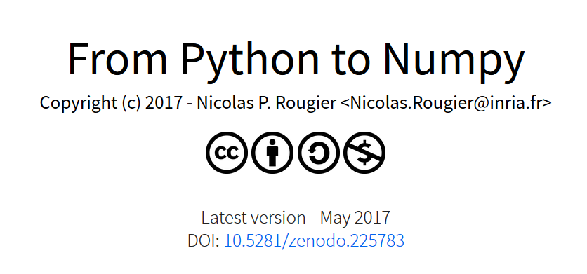

Numpy for scientific computing
Open access book!
Nicolas (Researcher)
https://www.labri.fr/perso/nrougier/from-python-to-numpy/

Slide 4
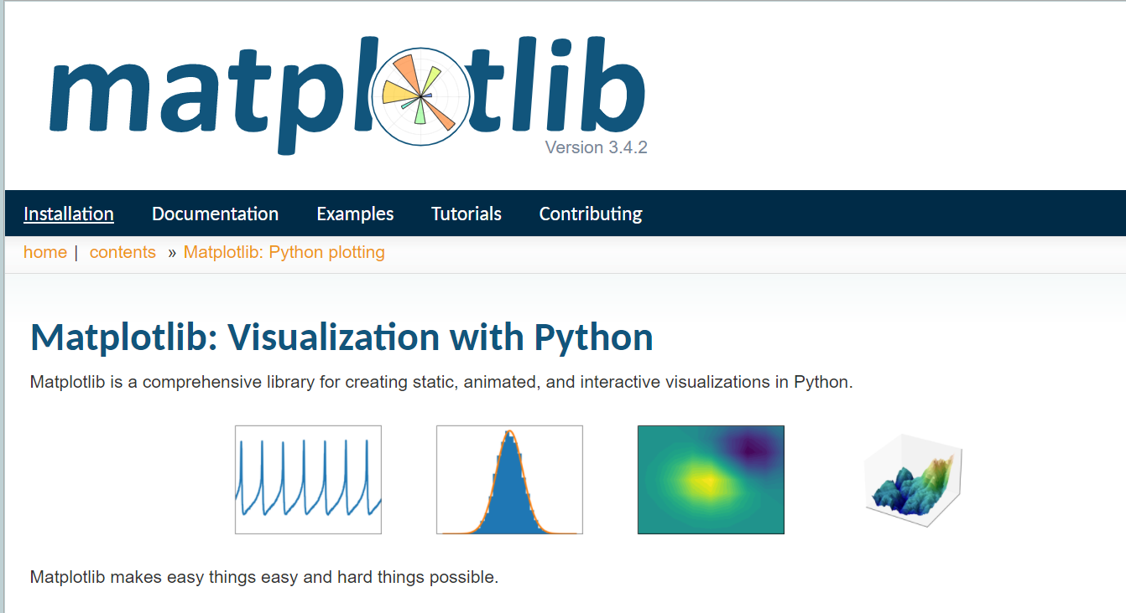
Matplotlib & the importance of data visualization!
The library:
https://matplotlib.org/stable/
https://github.com/rougier/matplotlib-tutorial
Nicolas (Researcher)

Slide 5
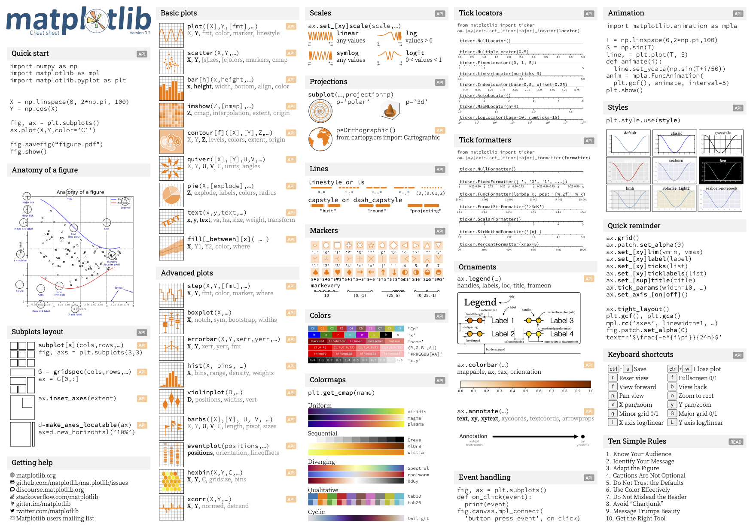
Matplotlib & the importance of data visualization!
Nicolas (Researcher)
https://github.com/matplotlib/cheatsheets

Slide 6
Ten simple rules for better figures
1. Know your audience
2. Identify your message
3. Adapt the figure to the support medium
4. Captions are not optional
5. Do not trust the defaults
6. Use color effectively
7. Do not mislead the reader
8. Avoid “chartjunk”
9. Message trumps beauty
10. Get the right tool
Nicolas (Researcher)
https://doi.org/10.1371/journal.pcbi.1003833

Slide 7
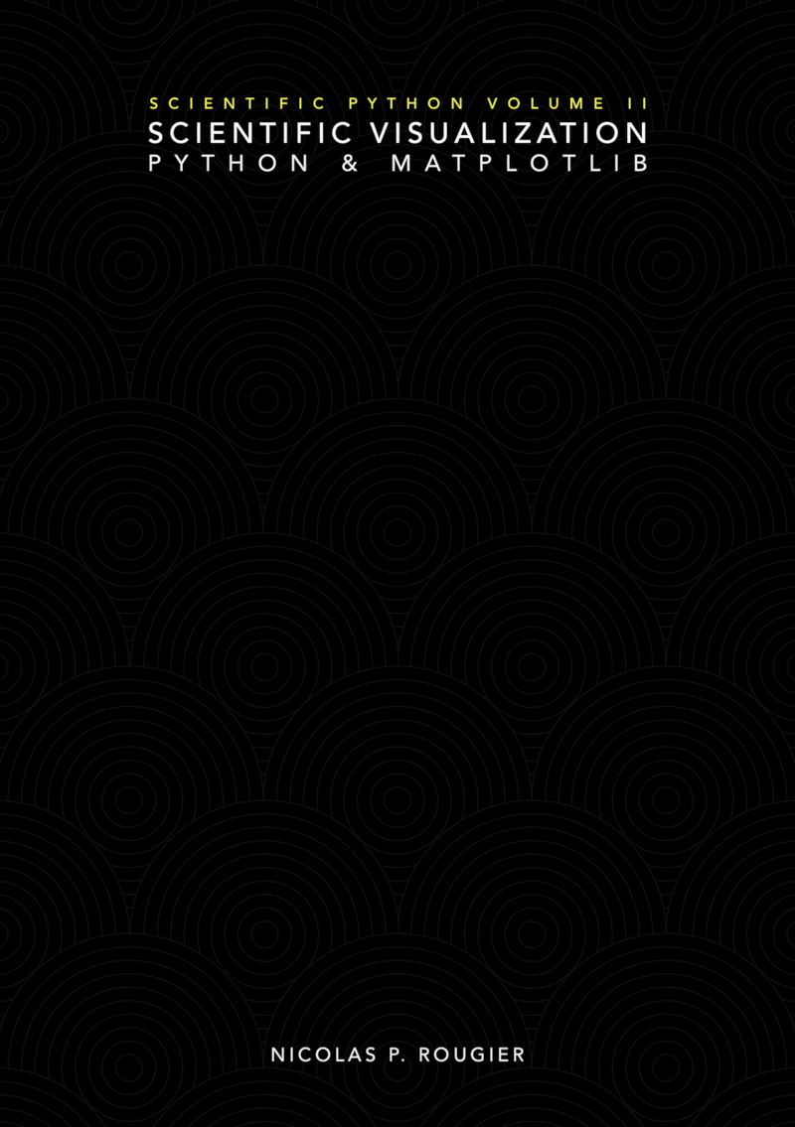
Matplotlib & the importance of data visualization!
Open access book!
https://github.com/rougier/scientific-visualization-book
Nicolas (Researcher)

Slide 8
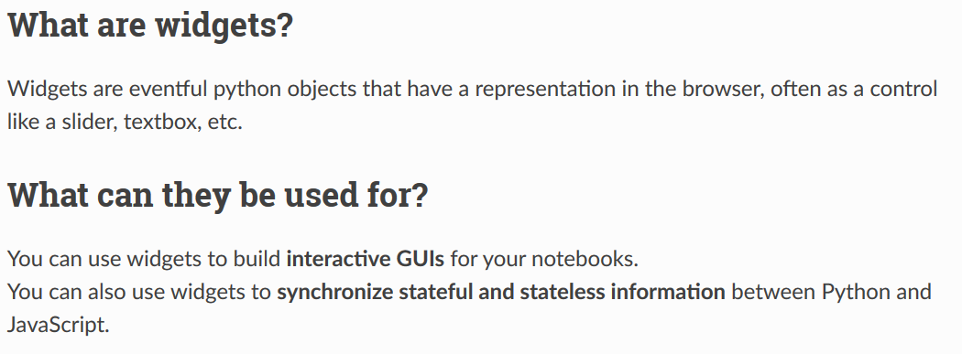
Jupyter Widgets
https://ipywidgets.readthedocs.io/en/latest/index.html

Slide 9
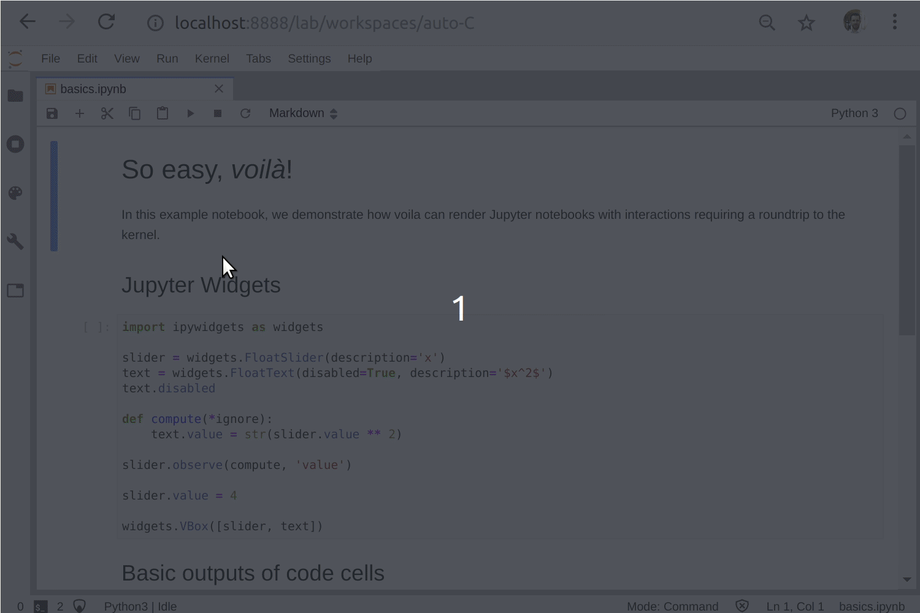
Jupyter Widgets

Slide 10
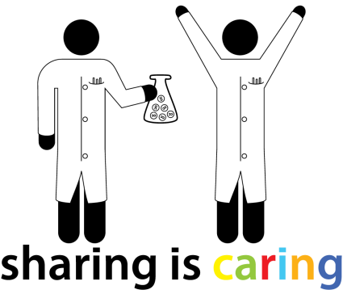

Thank you !
@BordeauxTea

